Slide 1


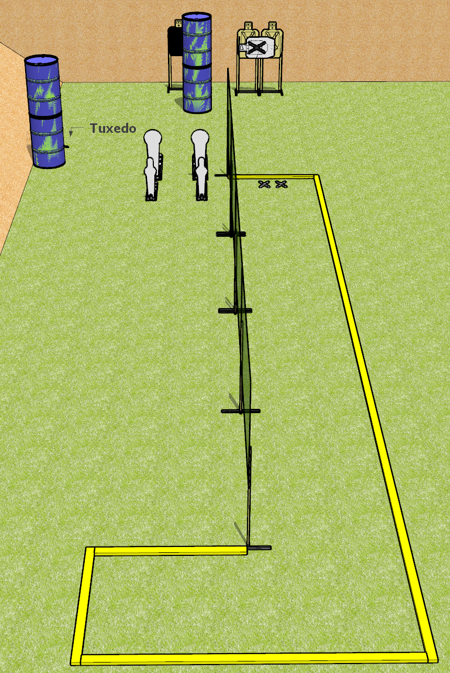
 | Dothan Gun Club – USPSA Match Don’t Trip Course Designer : Drew Coleman
START POSITION : Standing with both feet on X’s, wrists below belt
GUN READY CONDITION : Pistol loaded and holstered. PCC loaded, shouldered, muzzle pointed at cone. |  | SCORING: Comstock, 12 rounds TARGETS: 4 paper, 4 Steel SCORED HITS: Best 2 on paper, steel until down START-STOP: Audible, last shot RULES:
STAGE PROCEDURE: Engage targets as they become available from within the fault lines.

Slide 2
Don’t Trip
Written Stage Briefing
Don’t Trip is a 12 round, 60 point, Comstock Short Course. There are four USPSA targets, two Colt Speed Steel poppers, and two mini poppers. The best two hits per target will score. Steel must fall to score. The start signal is audible.
Handgun start position is feet on X’s, wrists below belt. Handgun is loaded and holstered
PCC start position is feet on X’s, loaded carbine held in both hands, safety on, shouldered, muzzle pointed at cone.
Upon start signal, engage targets as they become available from within the shooting area.

Slide 3
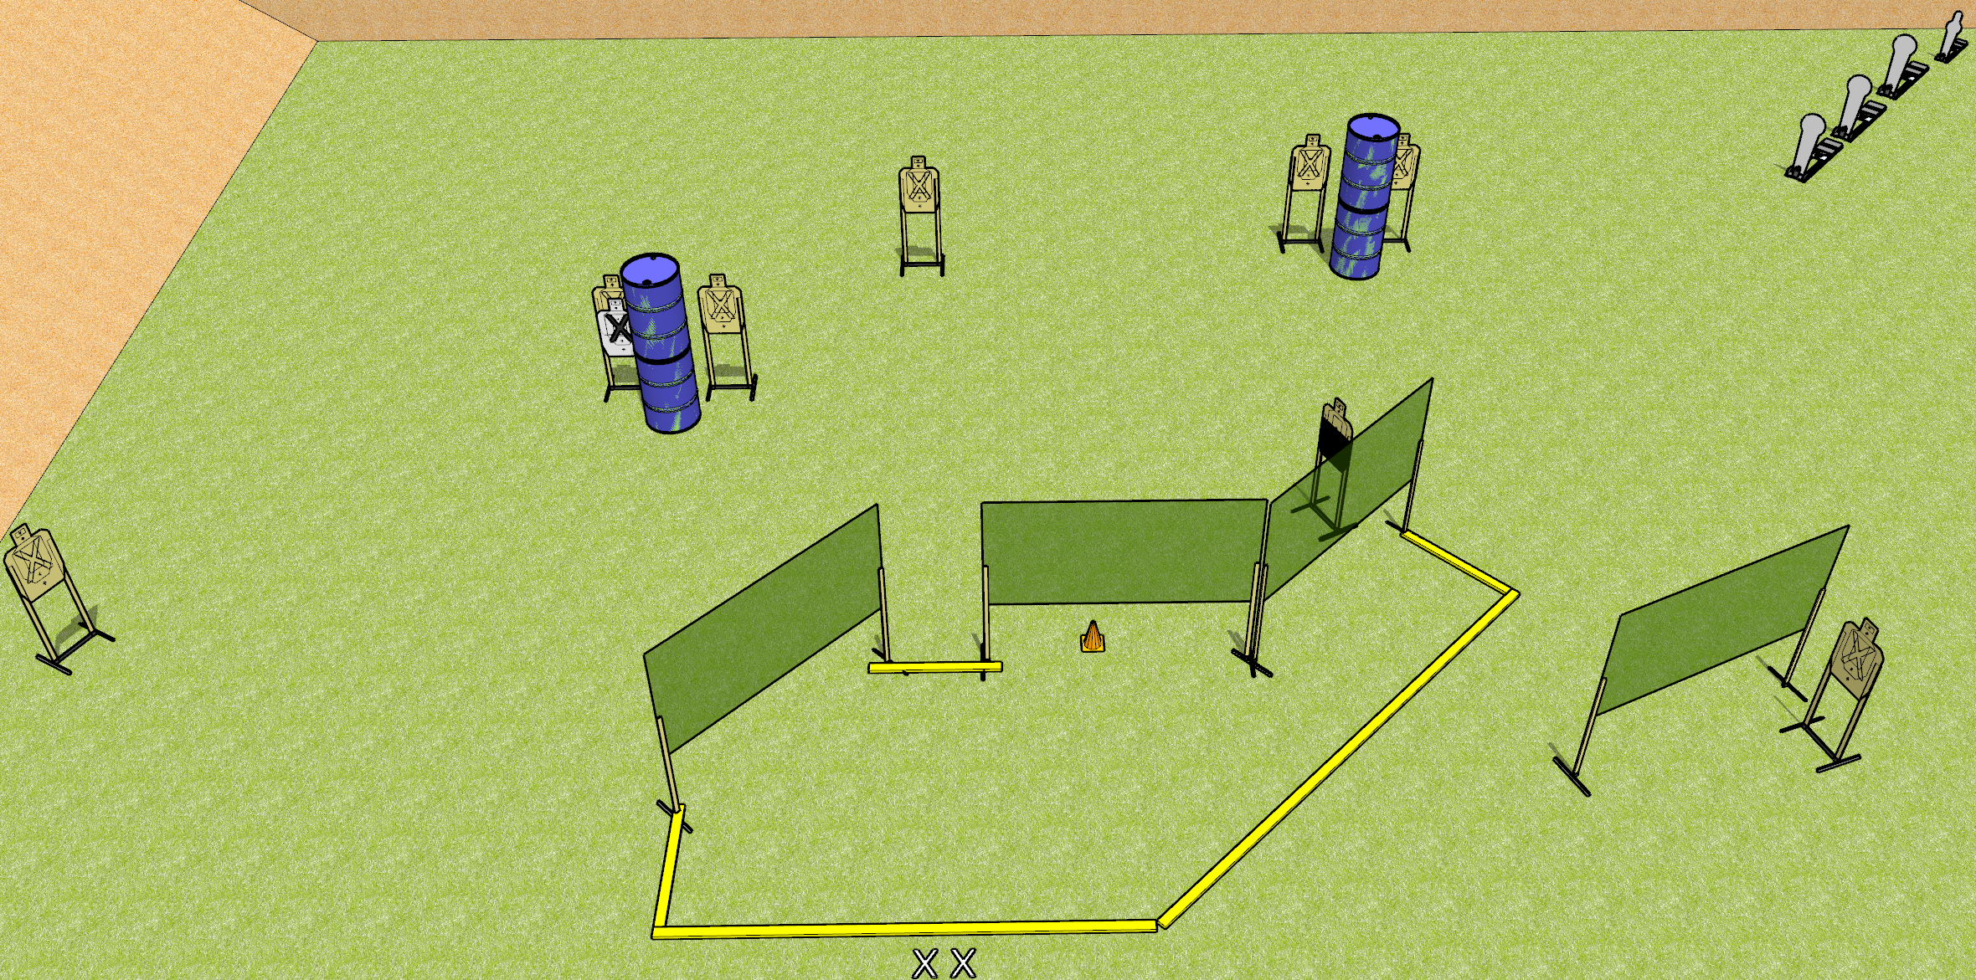
 | Dothan Gun Club – USPSA Match Conga Line Course Designer : Drew Coleman
START POSITION : Standing with both feet on X’s, wrists below belt
GUN READY CONDITION : Pistol loaded and holstered. PCC loaded, shouldered, safety on, pointed at orange cone. |  | SCORING: Comstock, 20 rounds TARGETS: 8 paper, 4 Steel SCORED HITS: Best 2 on paper, steel until down START-STOP: Audible, last shot RULES:
STAGE PROCEDURE: Engage targets as they become available from within the fault lines.

Slide 4
Stage Name
Written Stage Briefing
Conga Line is a 20 round, 100 point, Comstock Medium Course. There are eight USPSA targets, three Colt Poppers, and one mini popper. The best two hits on paper will score, and steel must fall to score. The start signal is audible.
Handgun start position is standing with both feet touching X’s outside the shooting area, wrists below belt. Handgun is loaded and holstered.
PCC start position is standing with both feet touching X’s outside the shooting area. Carbine is loaded, held with both hands, safety on, shouldered, pointed at orange cone.
Upon start signal engage targets as they become available from within the shooting area.

Slide 5
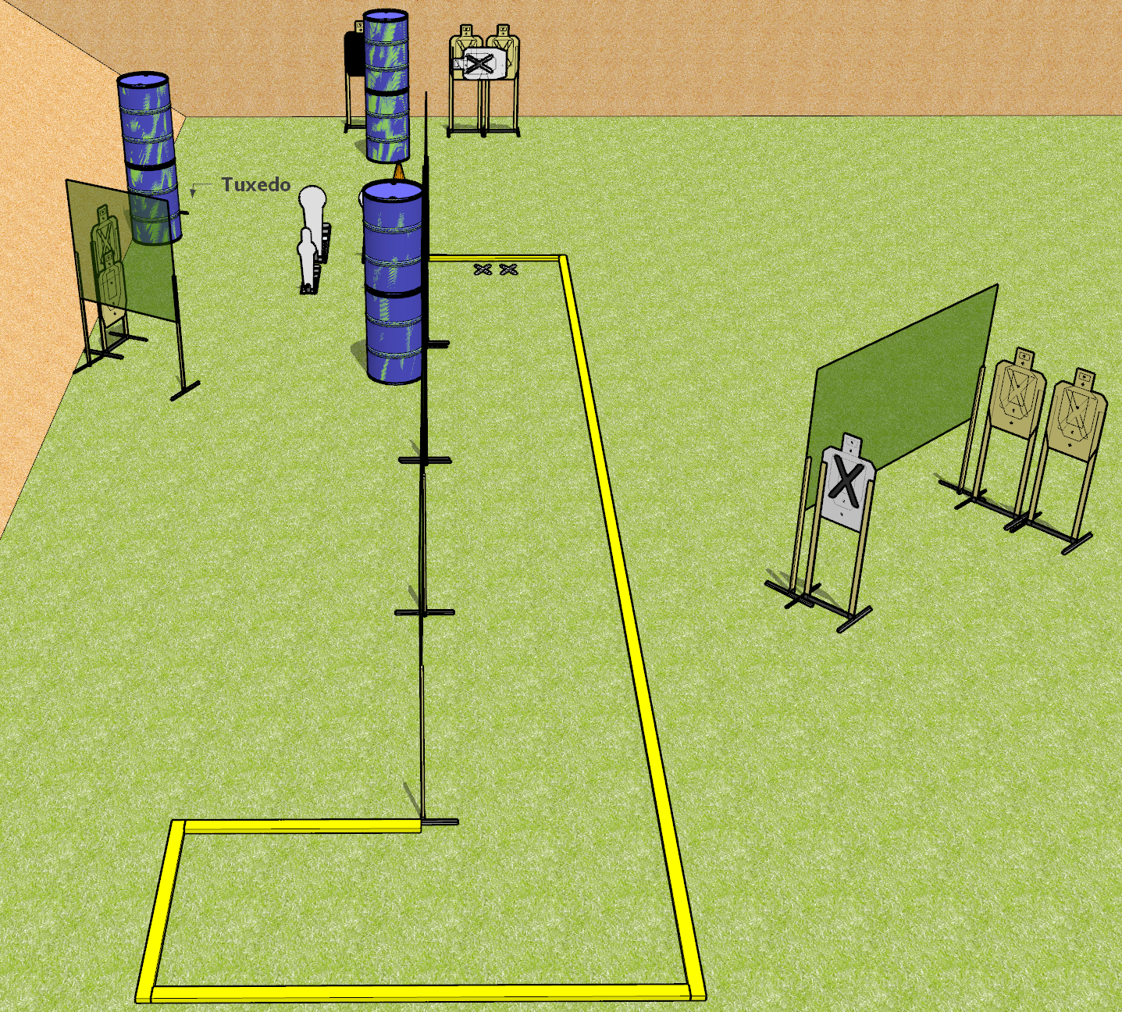
 | Dothan Gun Club – USPSA Match Run Away Course Designer : Drew Coleman
START POSITION : Standing with both feet on X’s, wrists below belt
GUN READY CONDITION : Pistol loaded and holstered. PCC loaded, shouldered, muzzle pointed at cone. |  | SCORING: Comstock, 20 rounds TARGETS: 8 paper, 4 Steel SCORED HITS: Best 2 on paper, steel until down START-STOP: Audible, last shot RULES:
STAGE PROCEDURE: Engage targets as they become available from within the fault lines.

Slide 6
Run Away
Written Stage Briefing
Run Away is a 20 round, 100 point, Comstock Medium Course. There are eight USPSA targets, two Colt Speed Steel poppers, and two mini poppers. The best two hits per target will score. Steel must fall to score. The start signal is audible.
Handgun start position is feet on X’s, wrists below belt. Handgun is loaded and holstered
PCC start position is feet on X’s, loaded carbine held in both hands, safety on, shouldered, muzzle pointed at cone.
Upon start signal, engage targets as they become available from within the shooting area.

Slide 7
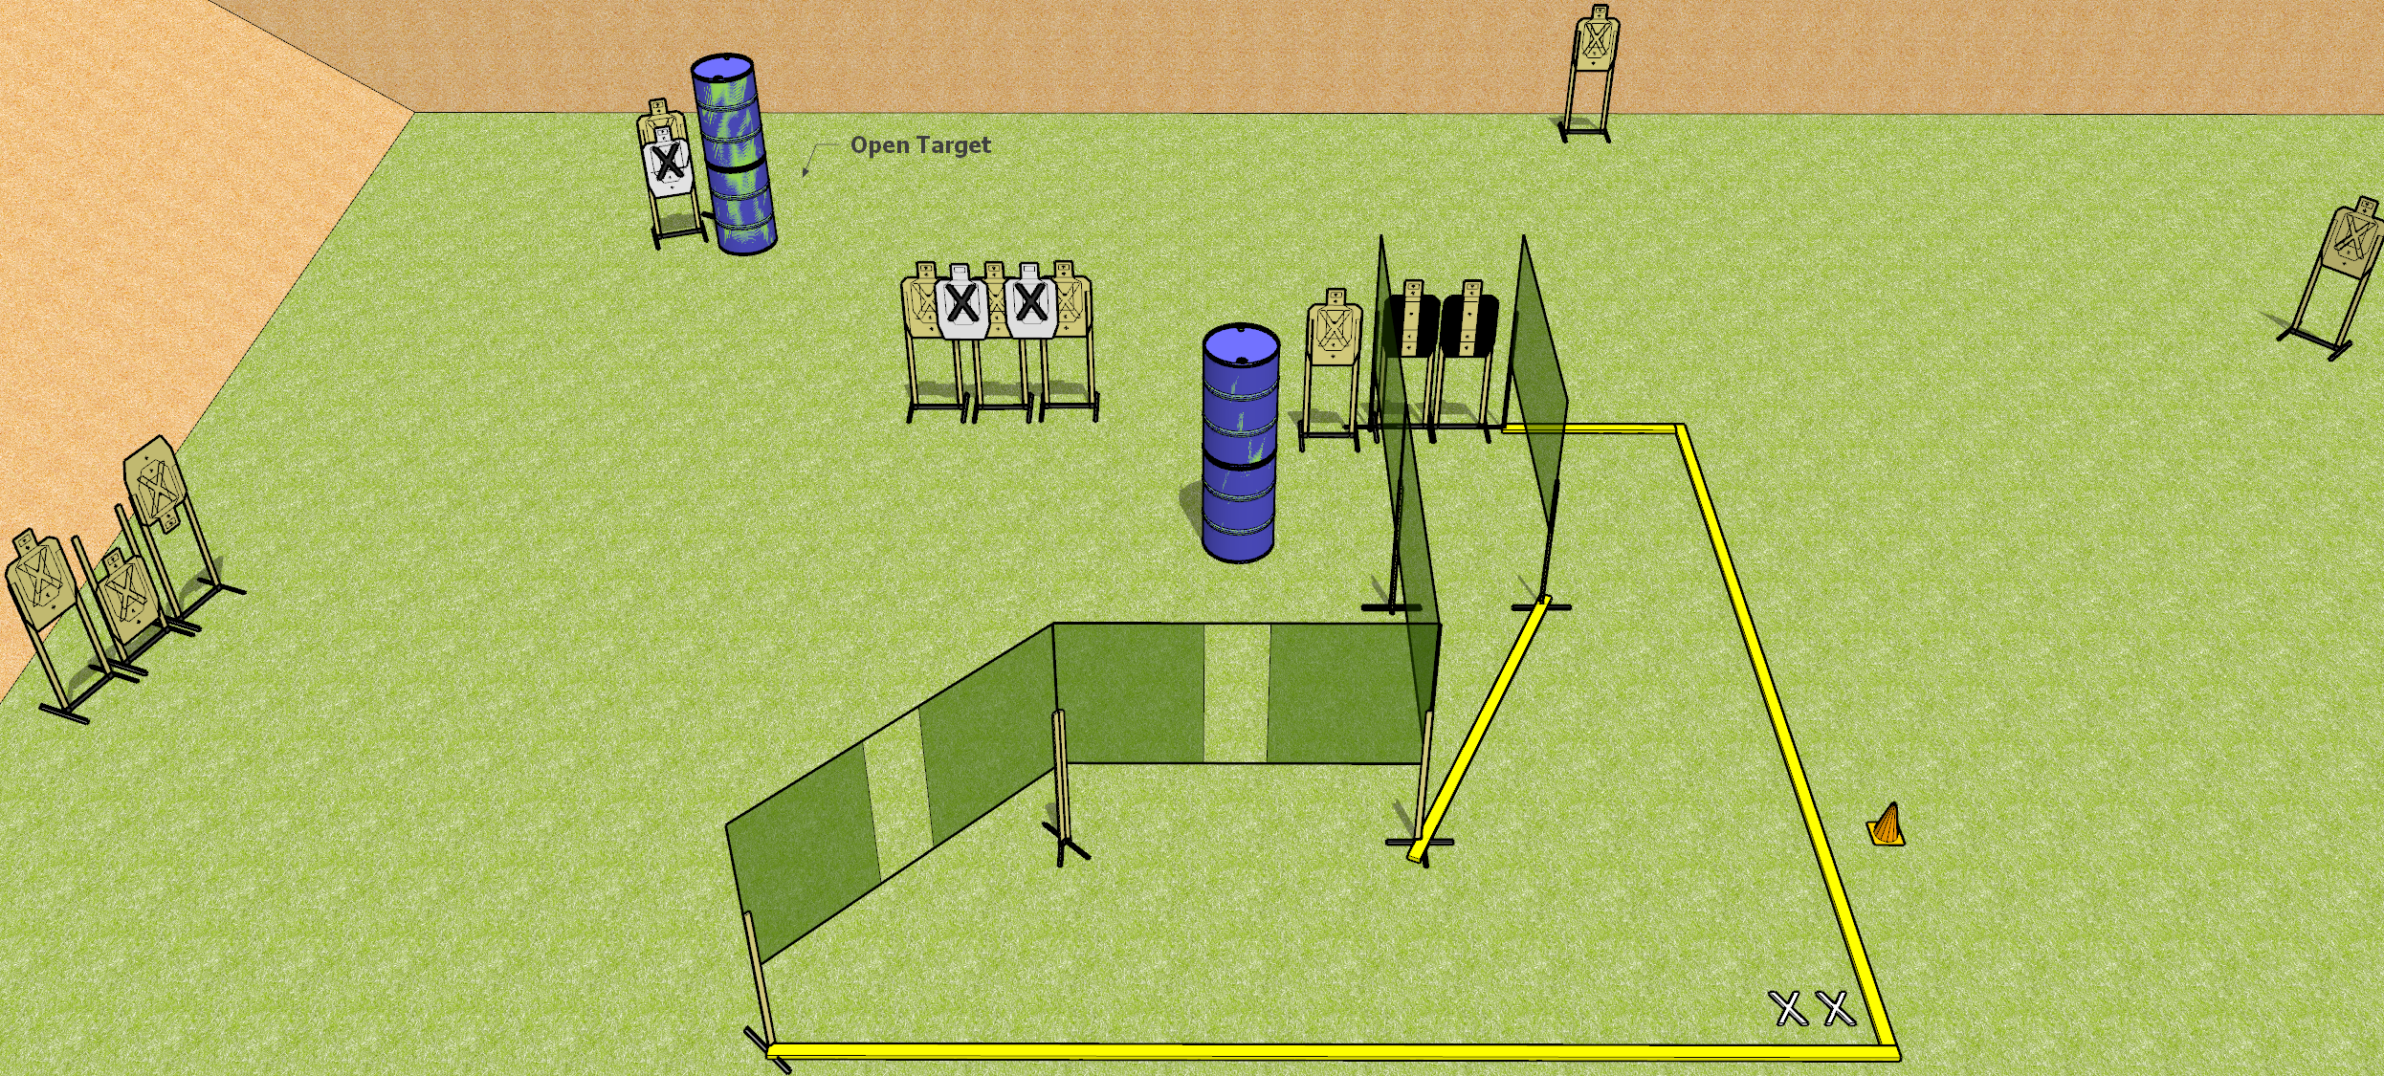
 | Dothan Gun Club – USPSA Match Fire Hose Course Designer : Drew Coleman
START POSITION : Standing with both feet covering X’s, wrists below belt
GUN READY CONDITION : Pistol loaded and holstered. PCC loaded, shouldered, safety on, pointed at orange cone. |  | SCORING: Comstock, 26 rounds TARGETS: 13 paper, 0 Steel SCORED HITS: Best 2 on paper, steel until down START-STOP: Audible, last shot RULES:
STAGE PROCEDURE: Engage targets as they become available from within the fault lines.

Slide 8
Fire Hose
Written Stage Briefing
Fire Hose is a 26 round, 130 point, Comstock Field Course. There are thirteen USPSA targets. The best two hits per target will score. The start signal is audible.
Handgun start position is feet covering X’s, wrists below belt. Handgun is loaded and holstered
PCC start position is feet covering X’s, loaded carbine held in both hands, safety on, shouldered, muzzle pointing at cone.
Upon start signal, engage targets as they become available from within the shooting area.

Slide 9
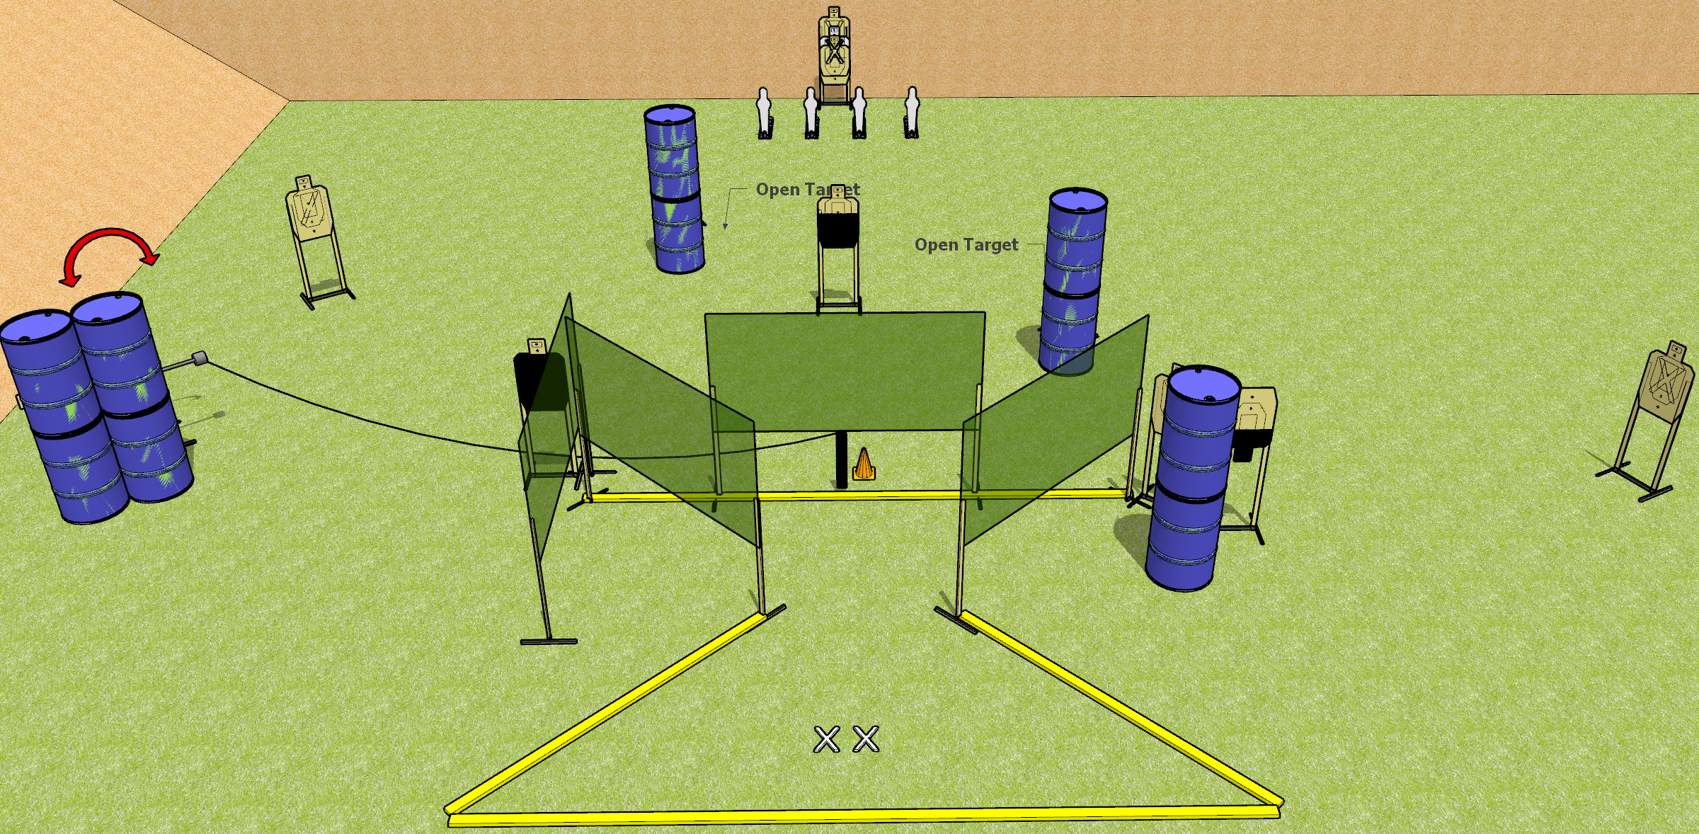
 | Dothan Gun Club – USPSA Match Ruffle Shuffle Course Designer : Drew Coleman
START POSITION : Standing with both feet on X’s, wrists below belt
GUN READY CONDITION : Pistol loaded and holstered. PCC loaded, shouldered, safety on, pointed at orange cone. |  | SCORING: Comstock, 26 rounds TARGETS: 11 paper, 4 Steel SCORED HITS: Best 2 on paper, steel until down START-STOP: Audible, last shot RULES:
STAGE PROCEDURE: Engage targets as they become available from within the fault lines.

Slide 10
Ruffle Shuffle
Written Stage Briefing
Ruffle Shuffle is a 26 rounds, 130 point, Comstock Field Course. There are eleven USPSA targets and four mini poppers. The best two hits per target will score. Steel must fall to score. The start signal is audible.
The handgun start position is both feet on X’s, gun loaded and holstered, wrists below belt.
The PCC start position is both feet on X’s. Loaded carbine held with both hands, safety on, shouldered, muzzle pointed at orange cone.
Upon start signal, engage targets as they become available from within the fault lines.

Slide 11
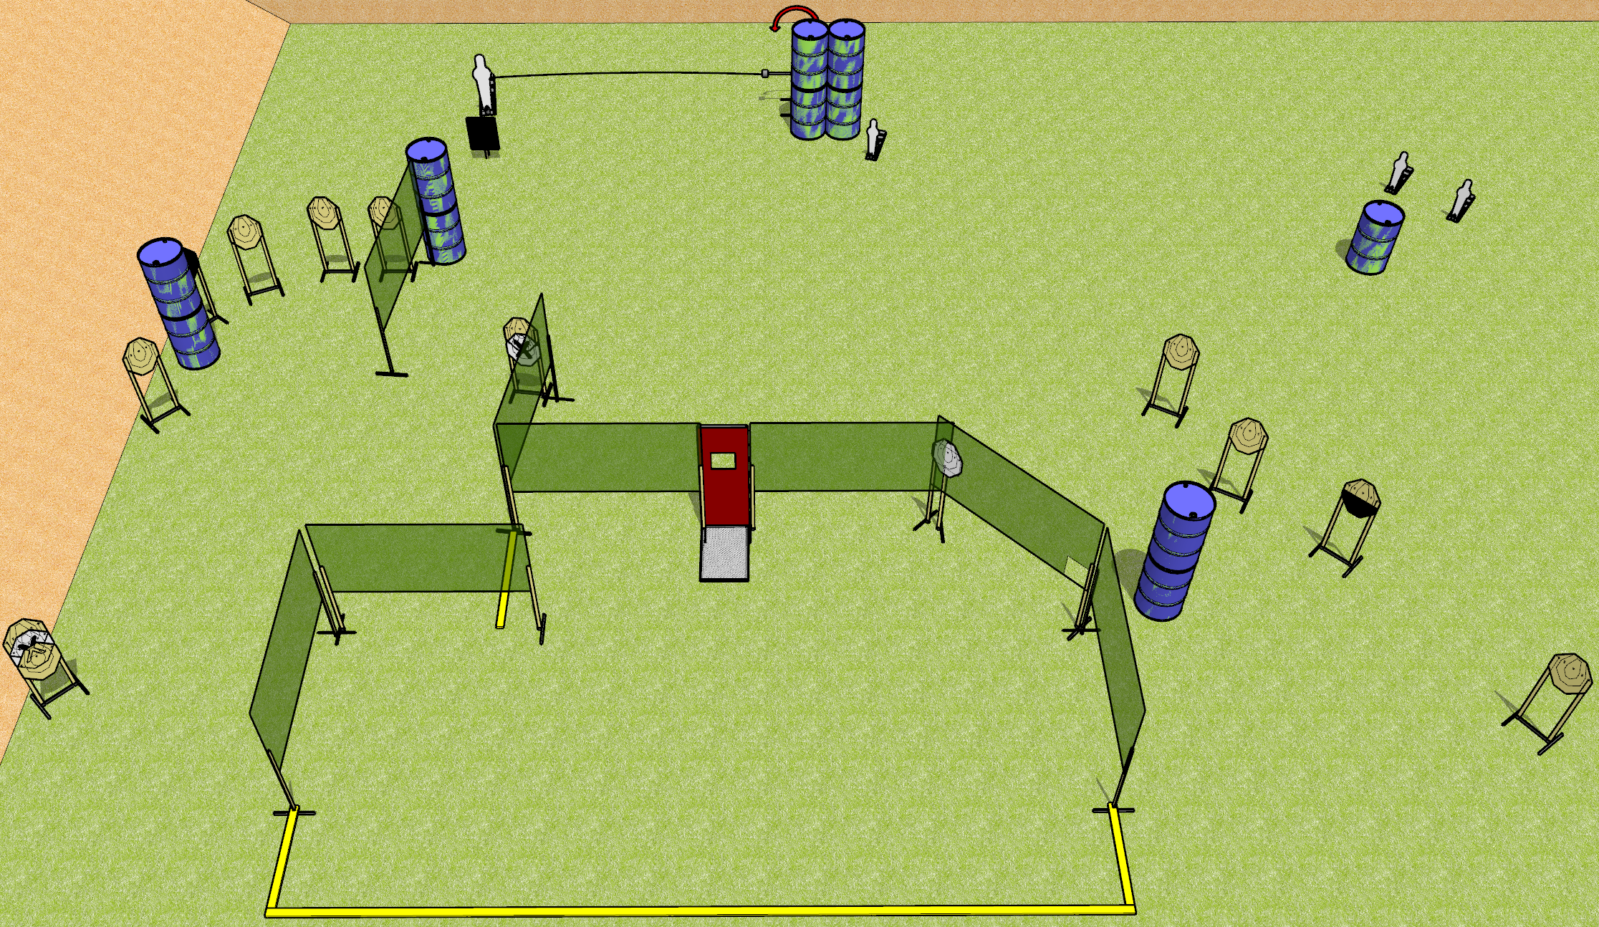
 | Dothan Gun Club – USPSA Match Window to the Soul Course Designer : Drew Coleman
START POSITION : Standing anywhere completely outside the shooting area. Hands relaxed at sides.
GUN READY CONDITION : Pistol loaded and holstered. PCC buttstock on belt, pointed in a safe direction. |  | SCORING: Comstock, 30 rounds TARGETS: 13 paper, 4 Steel SCORED HITS: Best 2 on paper, steel until down START-STOP: Audible, last shot RULES: REMEMBER TO USE USPSA NOT IPSC TARGETS
STAGE PROCEDURE: Engage targets as they become available from within the fault lines

Slide 12
Window to the Soul
Written Stage Briefing
Ruffle Shuffle is a 30 rounds, 150 point, Comstock Field Course. There are thirteen USPSA targets, one pepper popper, and three mini poppers. The best two hits per target will score. Steel must fall to score. The start signal is audible.
The handgun start position is standing completely outside the shooting area, gun loaded and holstered, wrists below belt.
The PCC start position is standing completely outside the shooting area. Loaded carbine held with both hands, safety on, buttstock on belt, pointed in a safe direction.
Upon start signal, engage targets as they become available from within the fault lines.

Slide 13
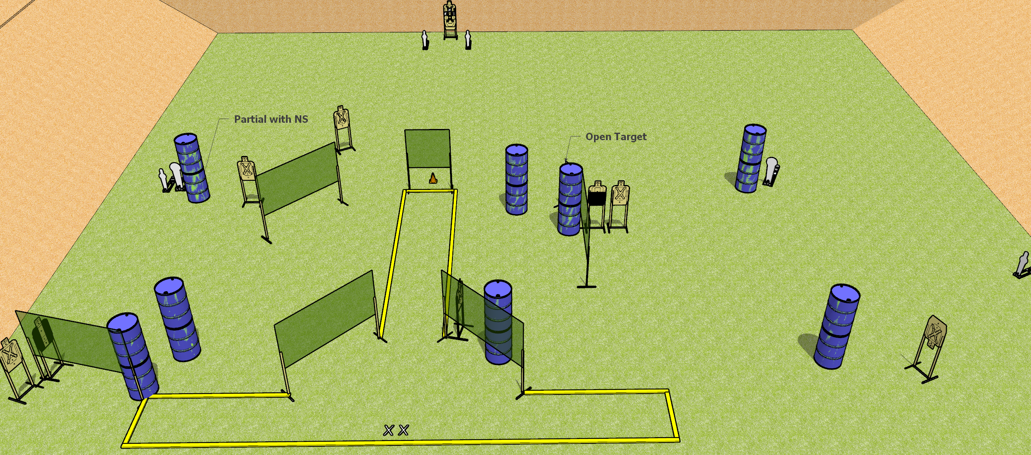
 | Dothan Gun Club – USPSA Match T-Route Course Designer : Patrick Free
START POSITION : Standing with both feet on X’s, wrists below belt
GUN READY CONDITION : Pistol unloaded and holstered, hammer down. PCC unloaded, shouldered, hammer down, pointed at orange cone. |  | SCORING: Comstock, 30 rounds TARGETS: 12 paper, 6 Steel SCORED HITS: Best 2 on paper, steel until down START-STOP: Audible, last shot RULES:
STAGE PROCEDURE: Engage targets as they become available from within the fault lines.

Slide 14
T-Route
Written Stage Briefing
T-Route is a 30 round, 150 point, Comstock Field Course. There are twelve USPSA targets, two Colt Poppers, and two mini poppers. The best two hits on paper will score and steel must fall to score. The start signal is audible.
Handgun start position is both feet on X’s, wrists below belt. Handgun is unloaded, hammer down, and holstered.
PCC start position is both on X’s. Unloaded carbine held with both hands, hammer down, shouldered, pointed at orange cone.
Upon start signal, engage targets as they become available from within the fault lines.

